Slide 1
Vocabulary 9/17/13

Slide 2
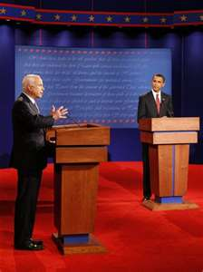
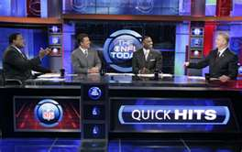
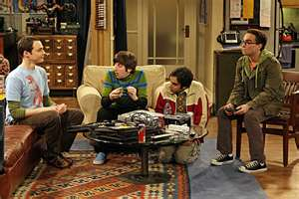
banter
an exchange of light, playful, teasing remarks or joking.
Noun

Slide 3
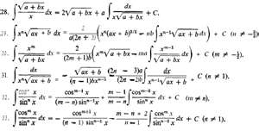
intricate
Detailed, complicated, complex, or hard to understand
Adjective

Slide 4
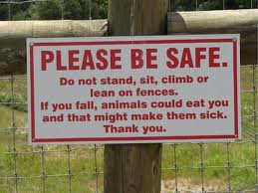
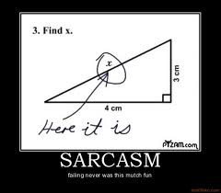
facetious
Teasing, sarcasm, not meant to be taken seriously or literally.
Adjective

Slide 5
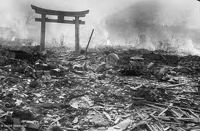
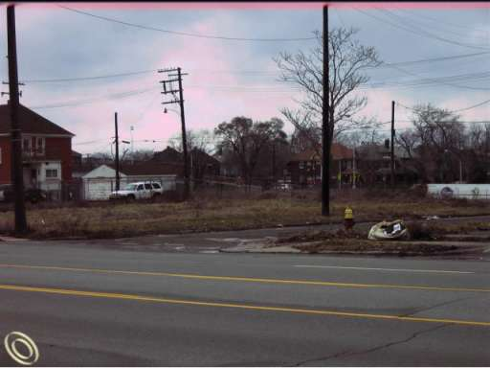
desolate
Empty, vacant, lonely, or solitary
Adjective

Slide 6
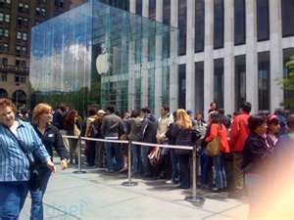
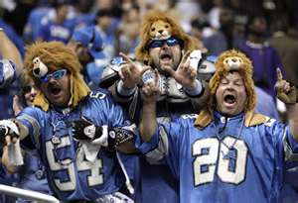
Ardent
intensely devoted, eager, or enthusiastic; passionate
Adjective

Slide 7
lucrative
Profitable, money making
Adjective

Slide 8
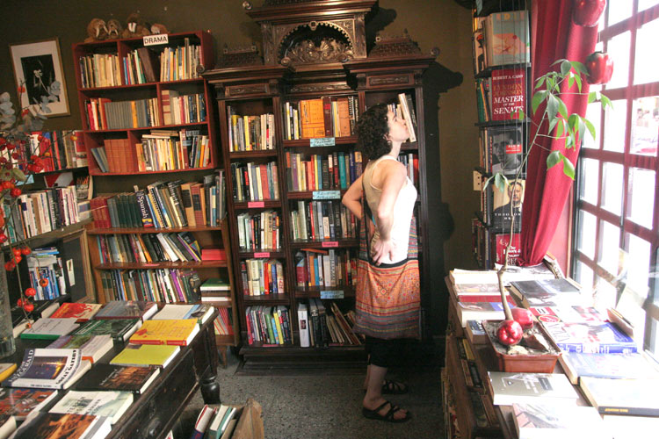
voracious
Hungry, greedy, great interest
Adjective

Slide 9
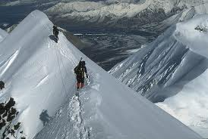
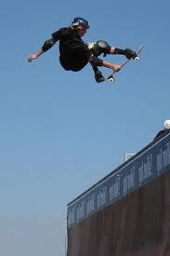
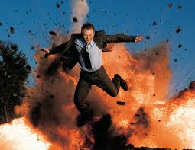
audacious
extremely bold or daring; recklessly brave; fearless
Adjective

Slide 10
connoisseur
Expert, judge, specialist
Noun

Slide 11
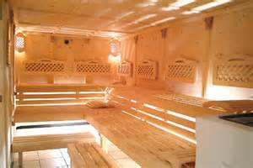
balmy
mild and refreshing; soft; soothing.
Adjective

