Slide 1
Vocabulary Variety
February 24, 2014

Slide 2
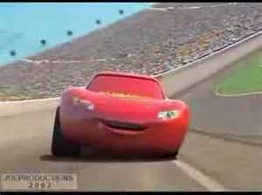
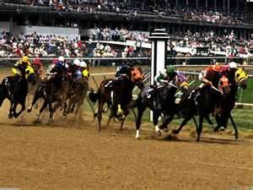
Falter
To weaken, fade, hesitate, fall behind
Verb

Slide 3
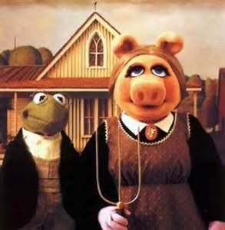
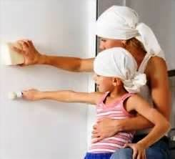
Mimic
To copy, imitate, impersonate
Verb

Slide 4
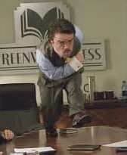
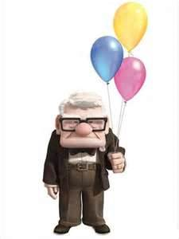
Ornery
Bad tempered, irritable, grouchy
Adjective

Slide 5
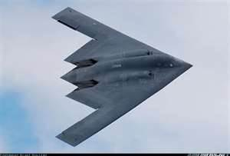
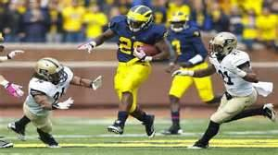
Elude
To get away, escape, avoid something
Verb

Slide 6
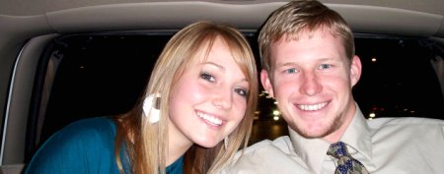
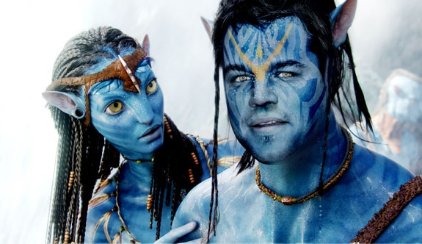
Rue
Regretful, or remorse, wish something had not happened
Verb

Slide 7
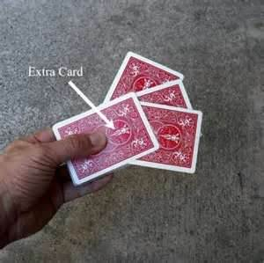
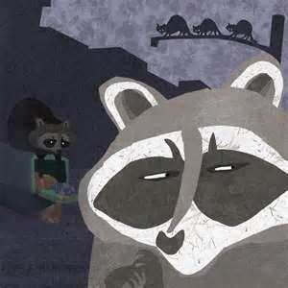
Cunning
Being sneaky or deceptive, tricky
Adjective

Slide 8
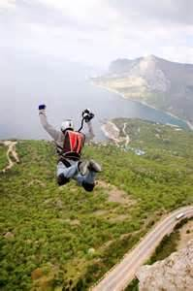
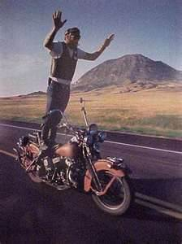
Reckless
Unconcerned about consequences, wild, careless, or uncontrollable
Adjective

Slide 9
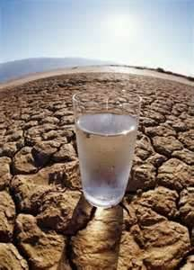
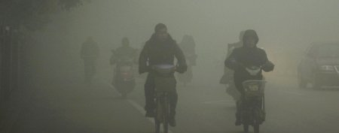
Vital
Extremely important, imperative, essential
Adjective

Slide 10
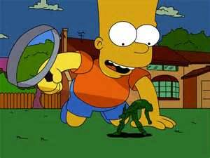
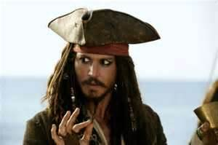
Roguish
Playful, mischievous, misbehaving
Adjective

Slide 11
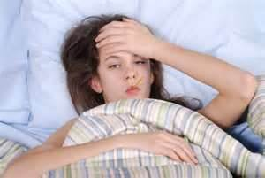
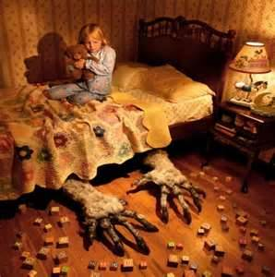
Recurring
Reappearing or occurring again, persistent
Adjective

