Slide 1
Vocabulary Review
September 10, 2013

Slide 2
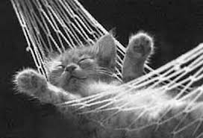
Passively
Without interest, unconcerned, inactive
Adverb

Slide 3
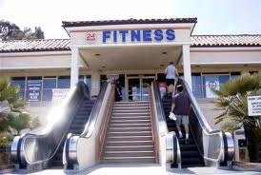
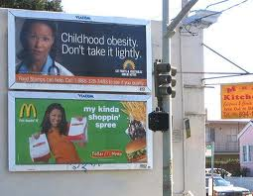
Absurd
Silly, strange, bizarre, ridiculous
Adjective

Slide 4
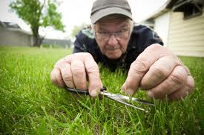
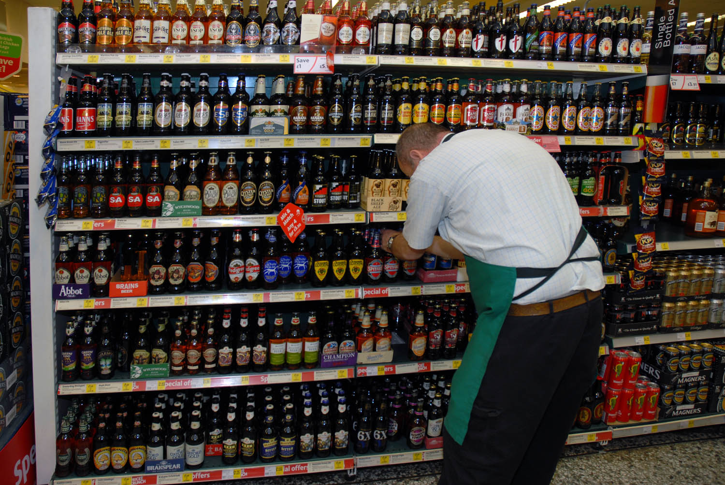
Meticulous
Extremely careful, paying attention to small details, thorough
Adjective

Slide 5
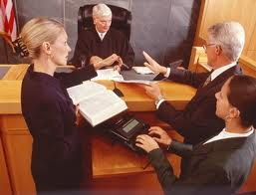
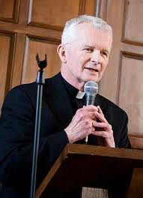
Intercede
Help on someone’s behalf, intervene, get involved
Verb

Slide 6
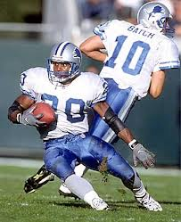
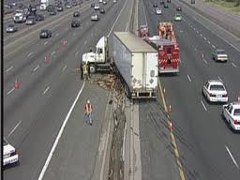
Abruptly
Rapidly, unexpectedly, surprised
Adverb

Slide 7
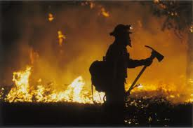
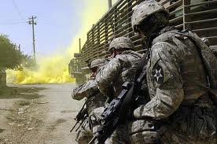
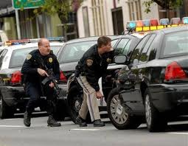
Valor
Bold or brave in the face of danger, courage, heroism
Noun

Slide 8
Implied
Understood without being stated, suggested, indirectly said
Verb

Slide 9
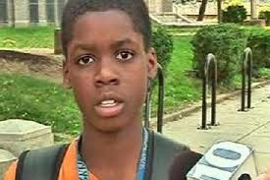
Bewilderment
State of confusion, lost or puzzled
Noun

Slide 10
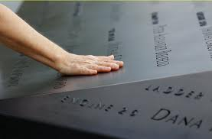
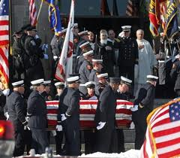
Somber
Extremely serious, glum, gloomy
Adjective

Slide 11
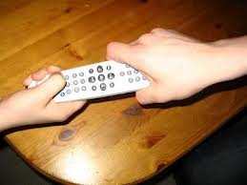
Petty
Unimportant, minor, little differences

