Slide 1
Vocabulary Frenzy
10/29/13

Slide 2
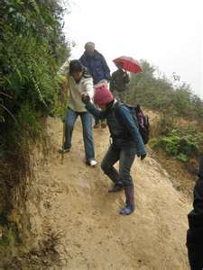
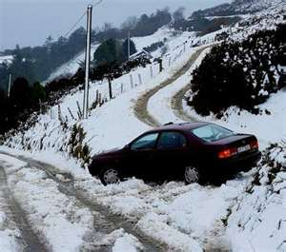
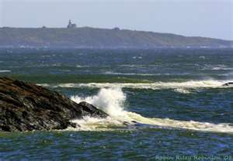
Treacherous
Dangerous, hazardous, risky unsafe
Adjective

Slide 3
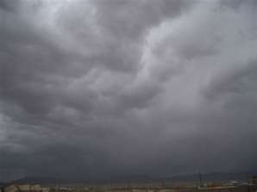
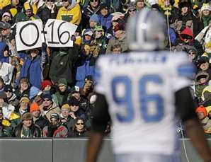
Dismal
Gloomy, dreary, cheerless
adjective

Slide 4
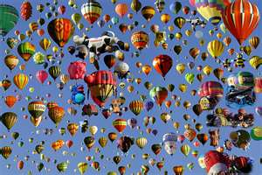
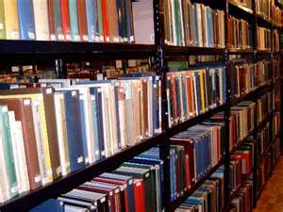
Superfluous
More than is sufficient or required; excessive.
Adjective

Slide 5
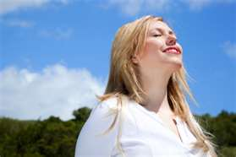
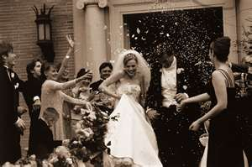
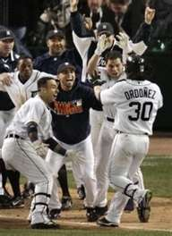
Bliss
supreme happiness; utter joy or contentment
Noun

Slide 6
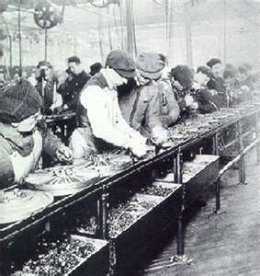
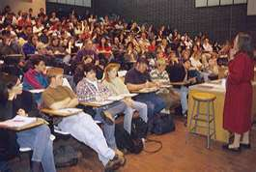
Mundane
Common, ordinary, unimaginative, boring
Adjective

Slide 7
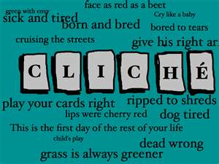
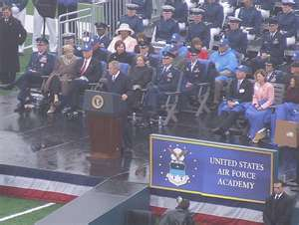
Trite
lacking in freshness or effectiveness because of constant use or excessive repetition;
Adjective

Slide 8
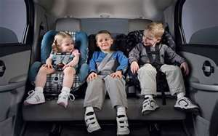
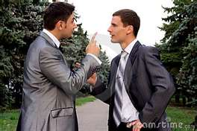
Bickering
an angry, petty dispute or quarrel; contention.
Noun

Slide 9
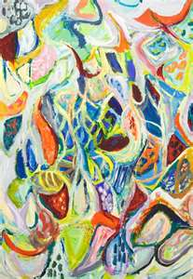
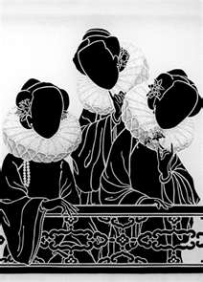
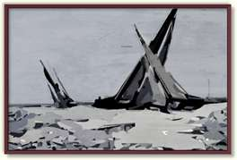
Ambiguous
lacking clearness or definiteness; obscure; indistinct:
Adjective

Slide 10
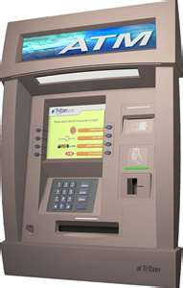
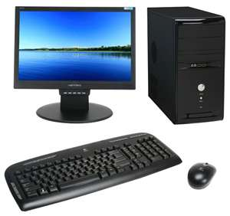
Redundant
Unnecessary, unneeded repetition in expressing ideas;
Adjective
ATM “MACHINE”
PC “Computer”

Slide 11
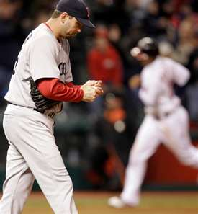
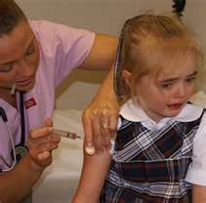
Avert
To turn or look away or aside
Verb

