Slide 1
Vocabulary Expressions
April 9, 2014

Slide 2
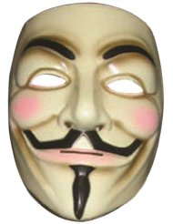
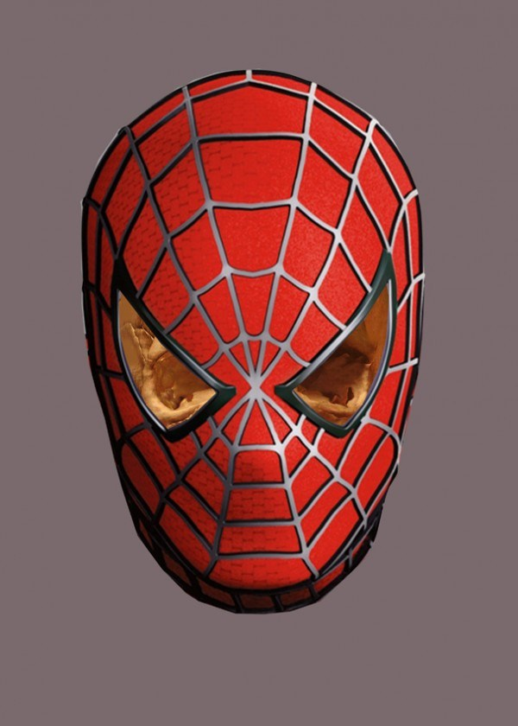
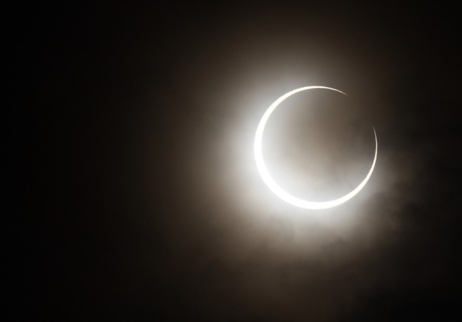
Obscure
Hidden or concealed
Verb

Slide 3
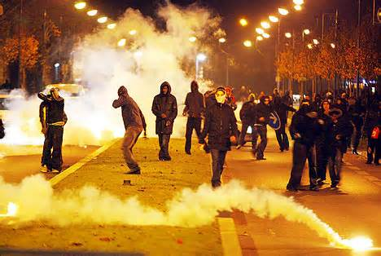
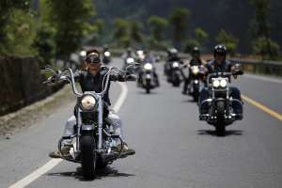
Raucous
Rough and loud noises, harsh and annoying
Adjective

Slide 4
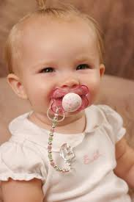
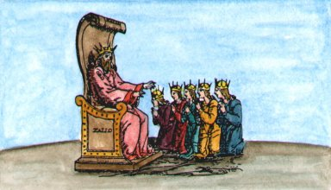
Appease
To put at ease, calm, pacify
Verb

Slide 5
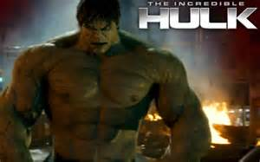
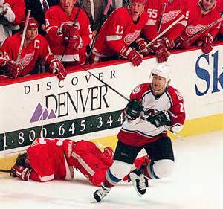
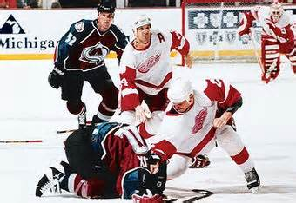
Wrath
Anger, fury, rage
Noun

Slide 6
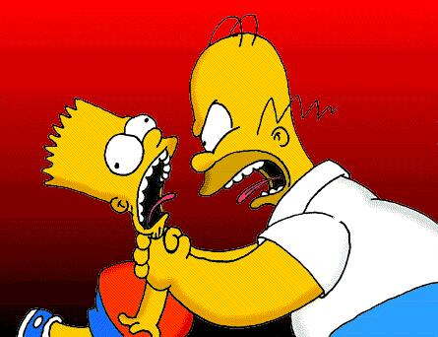
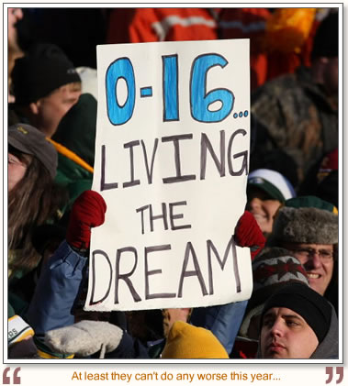
Inept
Clumsy, awkward, incompetent
Adjective

Slide 7
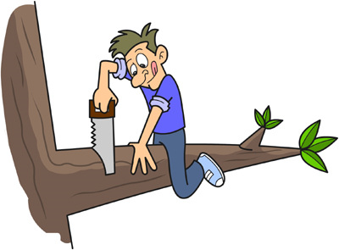
Oblivious
Unaware, unmindful, or unconscious of something happening
Adjective

Slide 8
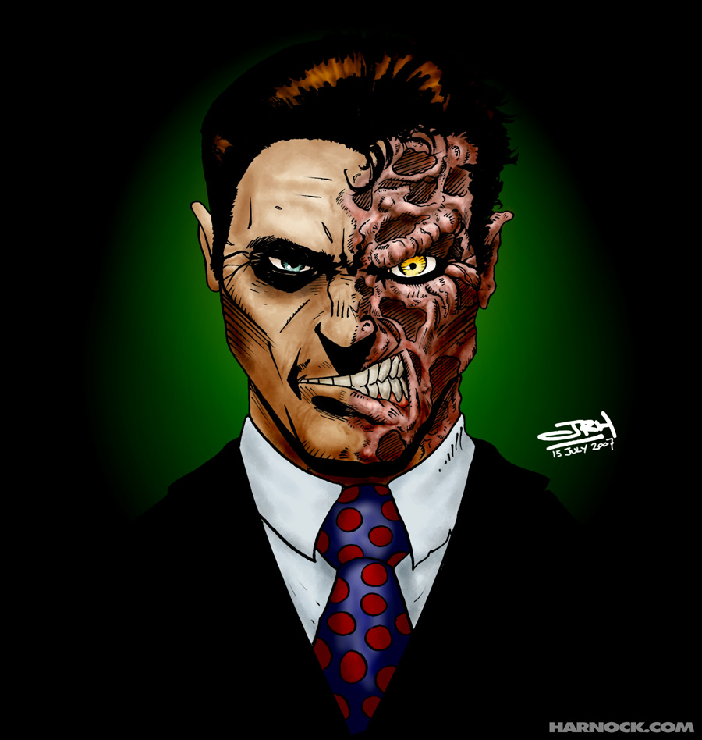
Fickle
Inconsistent, indecisive, always changing
Adjective

Slide 9
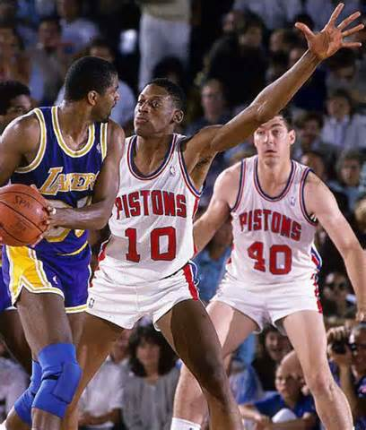
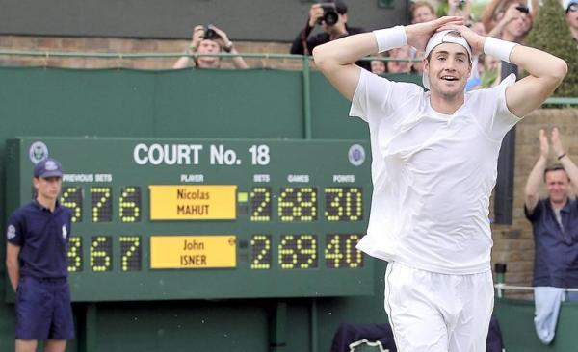
Tenacious
Hardworking, persistent, determined, never giving up, strong-willed
Adjective
Notes:
11 hours over three days, final score in the fifth set, 70-68

Slide 10
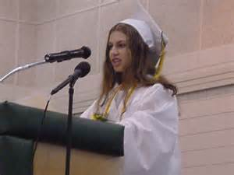
Poignant
Moving, emotional, touching
Adjective

Slide 11
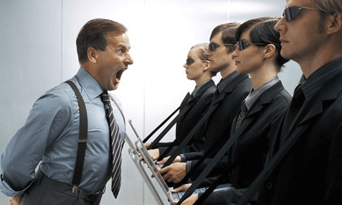
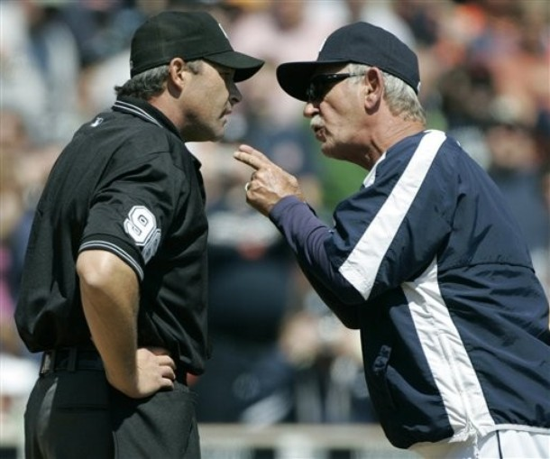
Chide
To express disapproval of, scold, criticize
Verb

