Slide 1
Extraordinary Vocabulary
May 6, 2014

Slide 2
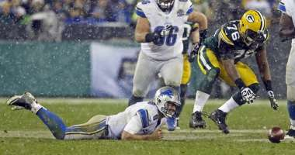
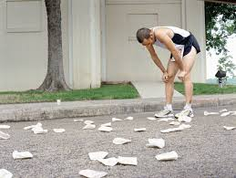
Languish
To get weaker, fade away, stuck
Verb

Slide 3
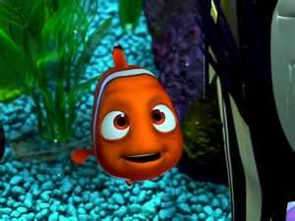
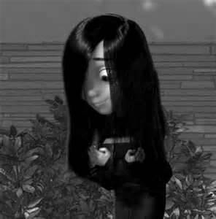
Diffident
Lacking confidence, shy, timid, hesitant
Adjective

Slide 4
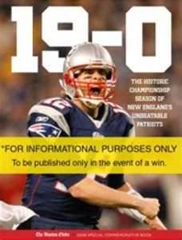
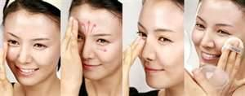
Blemish
Defect , flaw, something that keeps things from being perfect
Noun

Slide 5
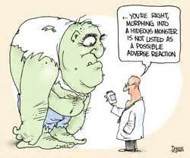
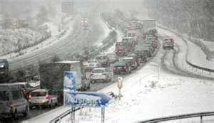
Adverse
Unfavorable and unpleasant effects
Adjective

Slide 6
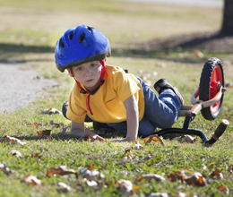
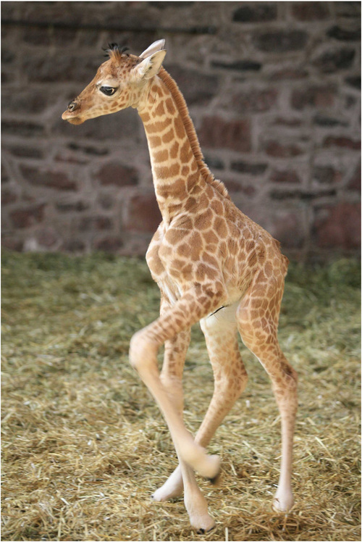
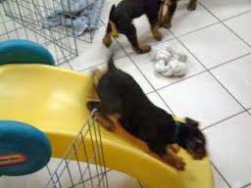
Ungainly
Clumsy, lack of grace, awkward
Adjective

Slide 7
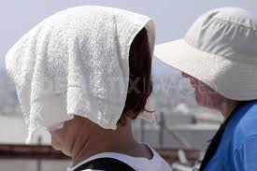
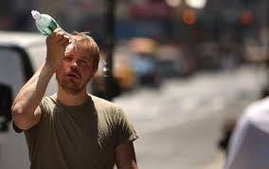
Swelter
To suffer from heat, burn, roast
Verb

Slide 8
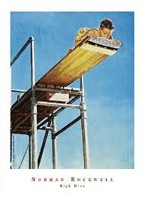
Muster
To gather, summon, collect
Verb

Slide 9
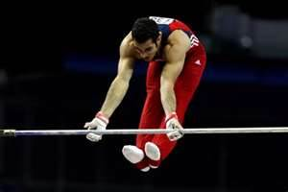
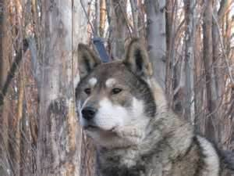
Agile
quick and well-coordinated in movement; moves with ease.
Adjective

Slide 10
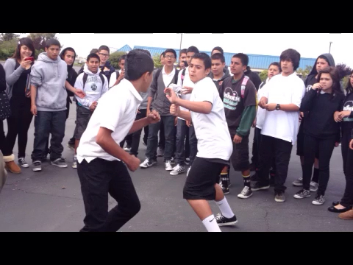
Gravitate
To move or sink towards something, to be attracted by
Verb

Slide 11
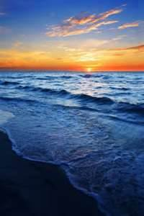
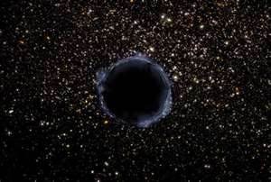
Infinite
Unlimited, never ending, countless
Adjective

