Slide 1
Vocabulary 4/29/14

Slide 2
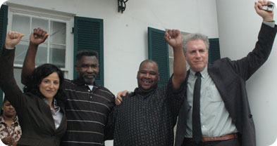
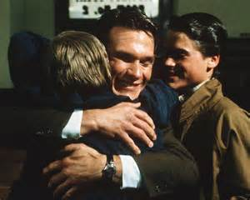
Exonerated
Cleared from accusation or blame.
v.

Slide 3
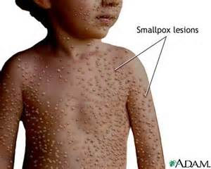
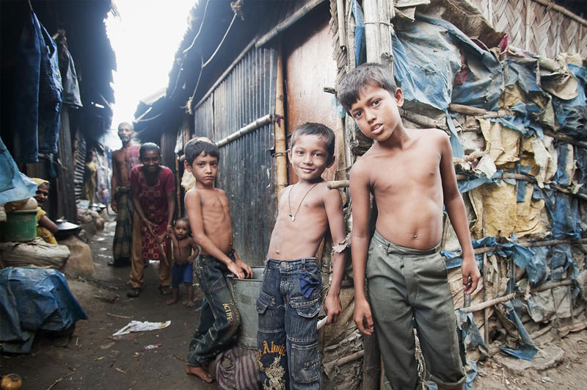
Eradicate
To do away with; destroy completely.
v.

Slide 4
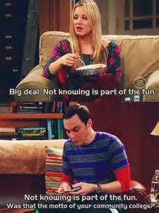
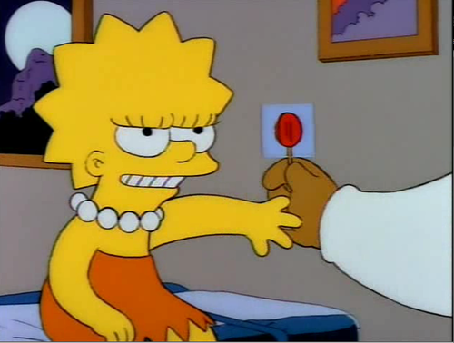
Patronize
To be condescending towards someone, arrogant, haughty towards
Verb

Slide 5
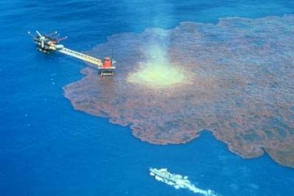
Dilute
To make less concentrated, weaken; diminish the strength, activity, or flavor
v.

Slide 6
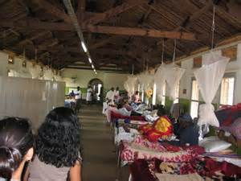
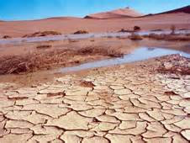
Scarce
Not plentiful or abundant, limited insufficient
adj.

Slide 7
Blithe
Carefree, without worry, without thought
Adj.

Slide 8
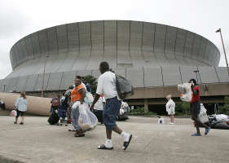
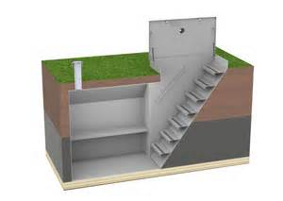
Refuge
Shelter or protection from danger or distress.
n.

Slide 9
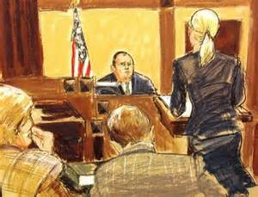
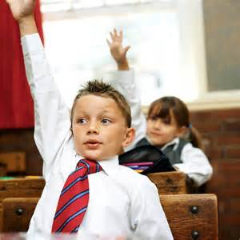
Query
A question; an inquiry
n.

Slide 10
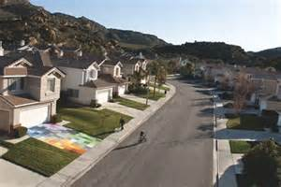
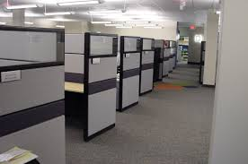
Nondescript
Lacking distinguishing characteristics, commonplace, dull.
adj.

Slide 11
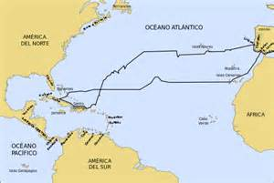
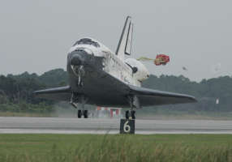
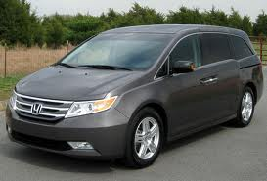
Odyssey
A long wandering or series of adventurous journeys.
n.

