Slide 1
Vocabulary 3/4/14

Slide 2
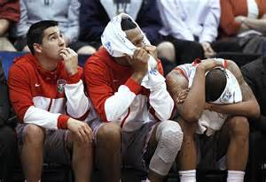
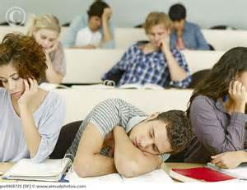
Slouch
- to sit or stand with an awkward, slumping, drooping posture-Verb

Slide 3
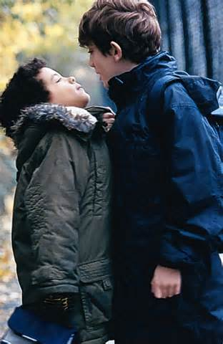
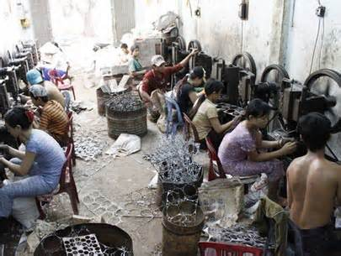
Exploit
– Take advantage of, to use selfishly for one's own ends-Verb

Slide 4
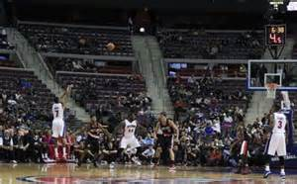
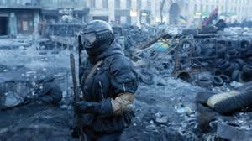
Bleak
- without hope or encouragement; depressing; dreary- Adjective

Slide 5
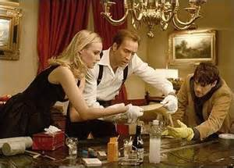
cryptic
– Hard to understand, puzzling, mysterious– adjective

Slide 6
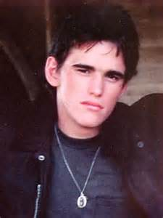
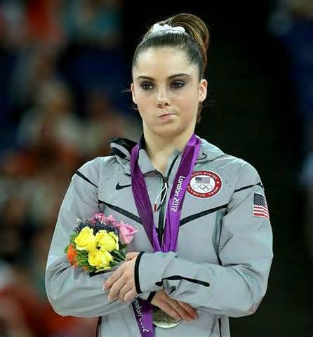
Scowl
– to have a threatening or gloomy facial expression-Verb

Slide 7
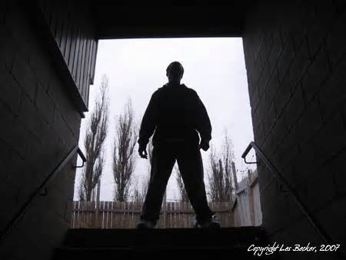
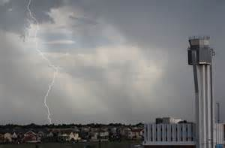
Menacing
– Something that is a threat, danger, hazard, or evil- adjective

Slide 8
Savvy
- perceptive knowledgeable; experienced and well-informed, adjective

Slide 9
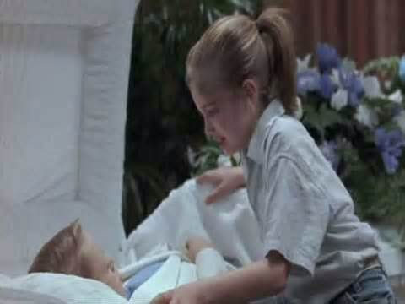
inconsolable
Can not be comfortable, extremely upset, devastated - adjective

Slide 10
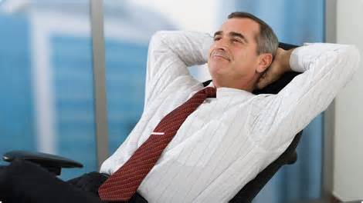
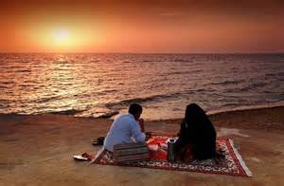
Content
- Satisfied, happy, at ease, comfortable – Adjective

Slide 11
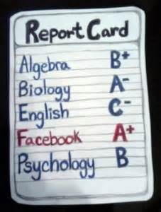
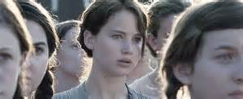
Numbly
– Unable to feel emotions, incapable of acting, indifferent - Adverb

