Slide 1
Vocabulary
March 18, 2014

Slide 2
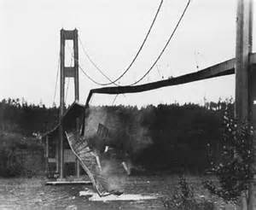
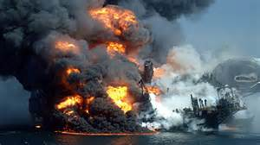
Debacle
when something becomes a disaster, fiasco
Noun

Slide 3
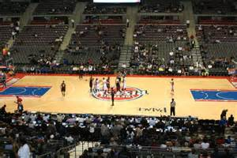
Wane
diminish, decrease or get smaller in intensity
Verb

Slide 4
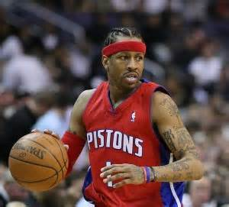
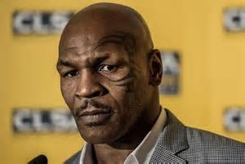
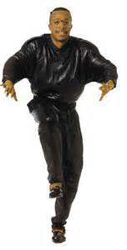
Squander
to waste an opportunity or money foolishly
Verb

Slide 5
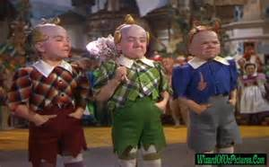
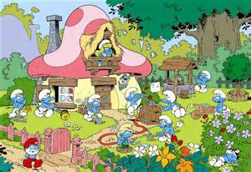
Diminutive
Miniature, tiny, very small
Adjective

Slide 6
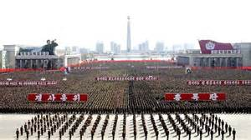
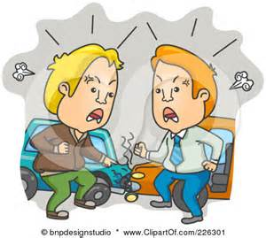
Escalate
to increase or soar in intensity
Verb

Slide 7
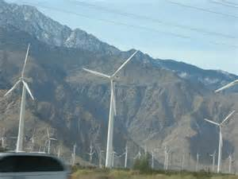
Proponent
person who is in favor of something, advocate, believer, sponsor, supporter
Noun

Slide 8
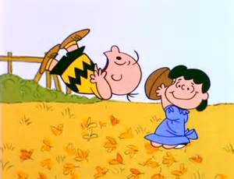
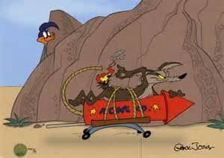
Wily
deceitful, crafty, cunning, trickery
Adjective

Slide 9
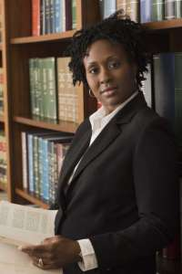
Aspire
to seek, desire, or want higher or better things
Verb

Slide 10
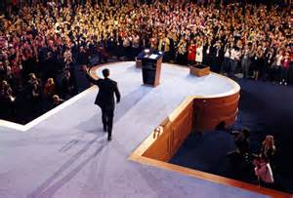
Concede
to hesitatingly accept as true, surrender, give up
Verb

Slide 11
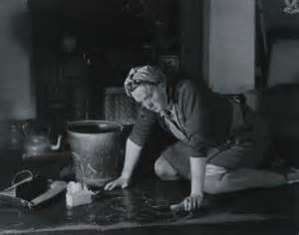
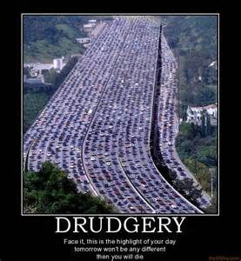
Drudgery
long dull, hard, boring work
Adjective

