Slide 1
Merry Vocabulary!!!
December 4, 2013

Slide 2
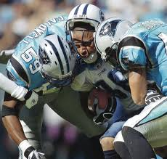
Crusade
any vigorous, aggressive movement for the defense or advancement of an idea, cause
Noun

Slide 3
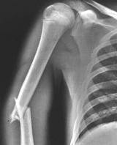
Excruciating
extremely painful; causing intense suffering; unbearably distressing; torturing
Adjective

Slide 4
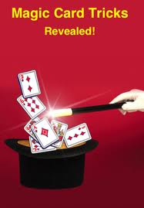
Deceptive
Misleading appearance, statements or movements
Adjective

Slide 5
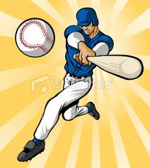
Adept
very skilled; proficient; talented
Adjective

Slide 6
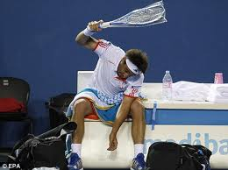
Tirade
a prolonged outburst of bitter, temper tantrum
Noun

Slide 7
Embark
To start, begin, initiate a task or journey
Verb

Slide 8
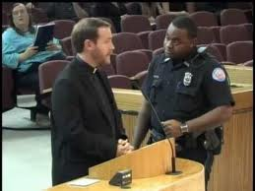
Wrangle
to argue or dispute, in a noisy or angry manner
Verb

Slide 9
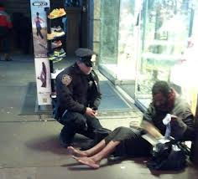
Benign
showing or expressive of gentleness or kindness
Adjective

Slide 10
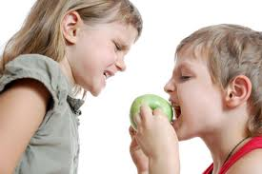
Intervene
to come between disputing people, groups
Verb

Slide 11
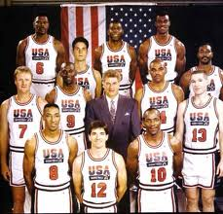
Formidable
causing fear, apprehension, or dread
Adjective

