Slide 1
Vocabulary Extravaganza
11/19/2013

Slide 2
Humane
characterized by tenderness, compassion, and sympathy for people and animals, especially for the suffering or distressed:
Adjective

Slide 3
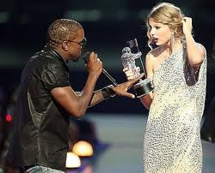
Rankle
To irritate, annoy, aggravate, upset
Verb

Slide 4
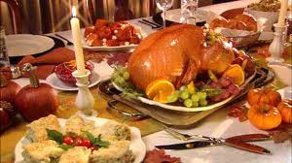
Glut
Excess, abundance, superfluity
Adjective

Slide 5
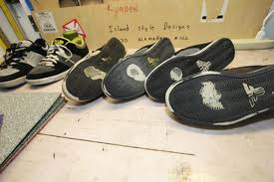
Avid
Eager, passionate, enthusiastic, and ardent
Adjective

Slide 6
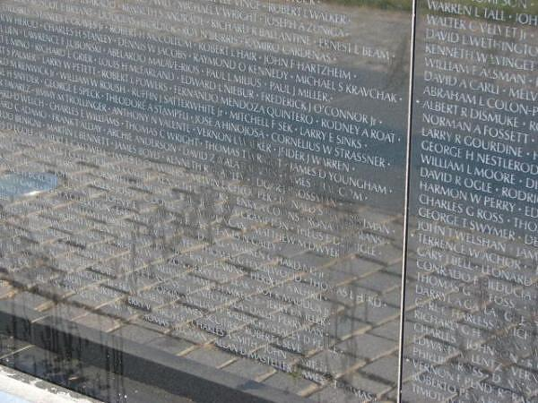
Deface
To destroy, damage, ruin, or disfigure
Verb

Slide 7
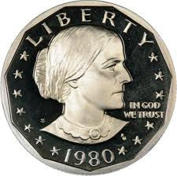
Advocate
Speaking on someone’s behalf, supporter
Verb

Slide 8
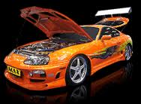
Modify
To change, adjust, alter
Verb

Slide 9
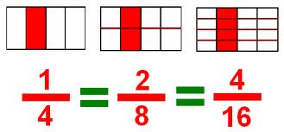
Exemplify
To show, demonstrate, or illustrate, example
Verb

Slide 10
Plausible
Reasonable, believable, credible, likely to be possible
Adjective

Slide 11
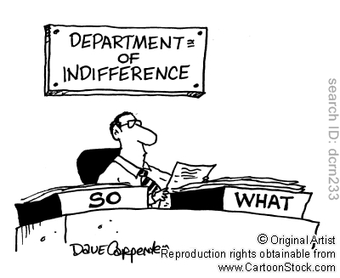
Indifferent
Uninterested, unconcerned, uncaring, not to be bothered by something.
Adjective

