Slide 1
VOCABULARY CELEBRATION
10-22-13

Slide 2
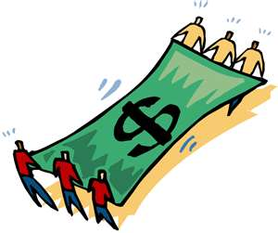
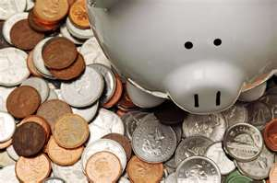
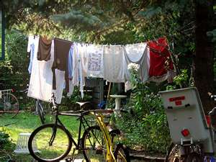
FRUGAL
(adjective)
-penny-pinching, penny-wise, cheap, stingy

Slide 3
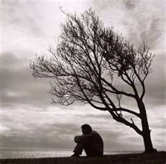
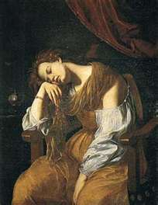
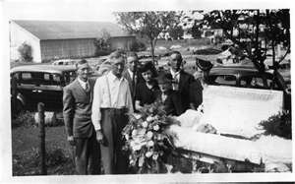
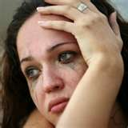
MELANCHOLY
(adjective) –
Sad, depressed, miserable

Slide 4
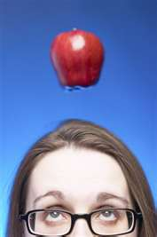
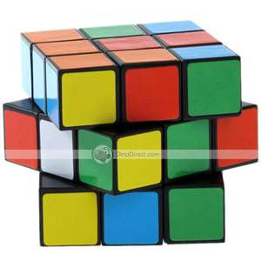
INTRIGUE
(verb)
– to puzzle or excite the curiosity, capture your imagination

Slide 5
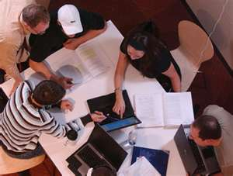
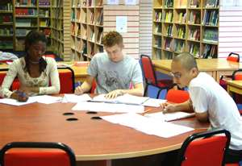
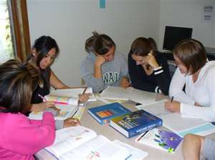
PERUSE
(verb)
- to read thoroughly and examine carefully

Slide 6
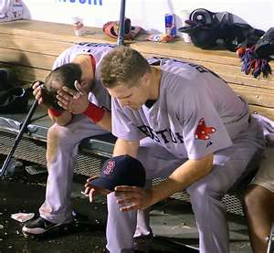
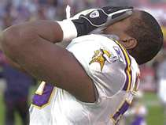
ANGUISH
(noun, verb)
- (n) great suffering, distress, or pain;
(v) to be deeply tormented by pain or sorrow

Slide 7
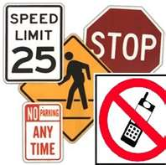
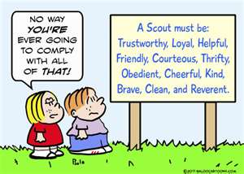
COMPLY
- to yield to a request or command Follow Directions
(verb)

Slide 8
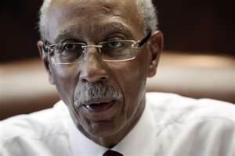
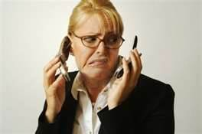
Flustered
Nervous, anxious, worried, uncomfortable
Verb

Slide 9
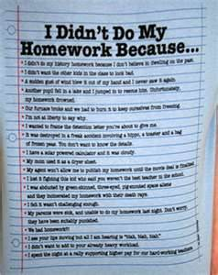
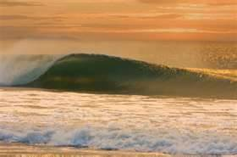
Sporadic
Irregular, inconsistent, not frequent
Adjective

Slide 10
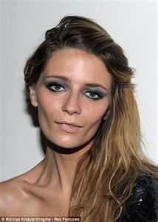
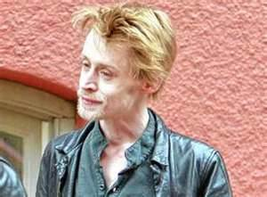
Gaunt
Extremely skinny, bony, similar to anorexic
Adjective

Slide 11
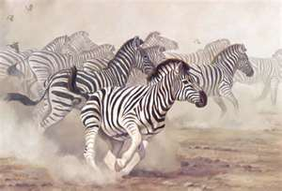
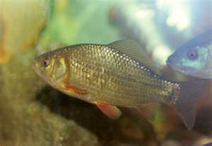
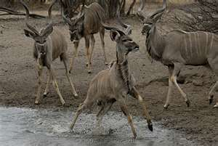
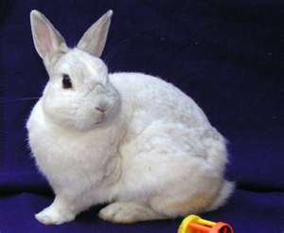
SKITTISH
(adjective)
- extremely nervous and easily frightened;
shy or timid; extremely cautious;

