Slide 1
Vocabulary 10/10/13

Slide 2
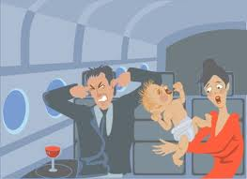
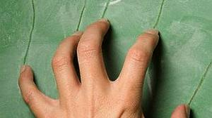
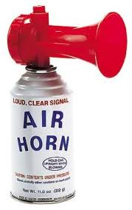
Strident
Irritating, unpleasant sounds, grating
Adjective

Slide 3
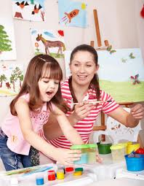
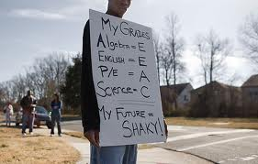
Foster
Encourage, promote, advance, support
Verb

Slide 4
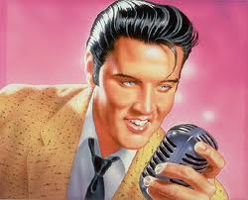
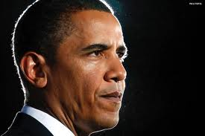
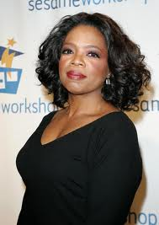
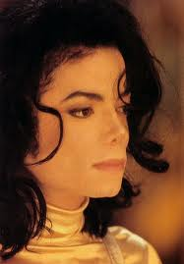
Renown
Fame: well known, celebrity, popular reputation
Noun

Slide 5
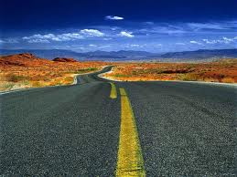
Tedious
Long, tiresome, boring
Adjective

Slide 6
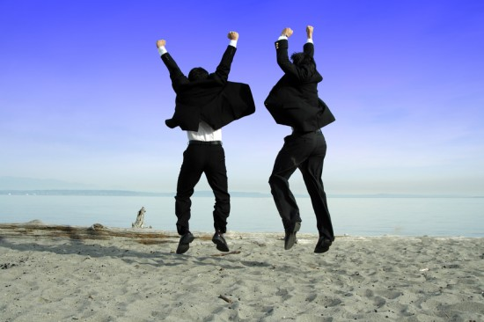
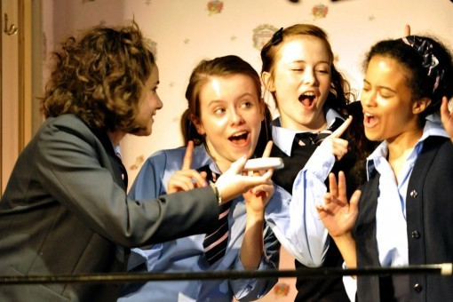
Spontaneous
Spur of the moment, unplanned, impulsive
Adjective

Slide 7
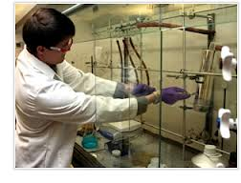
Imperative
Important, essential, urgent
Adjective

Slide 8
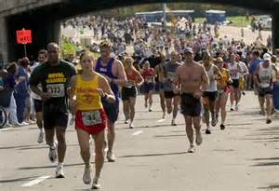
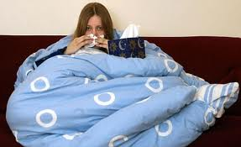
Susceptible
Influenced by other things, vulnerable, at risk.
Adjective

Slide 9
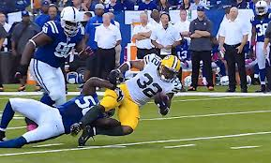
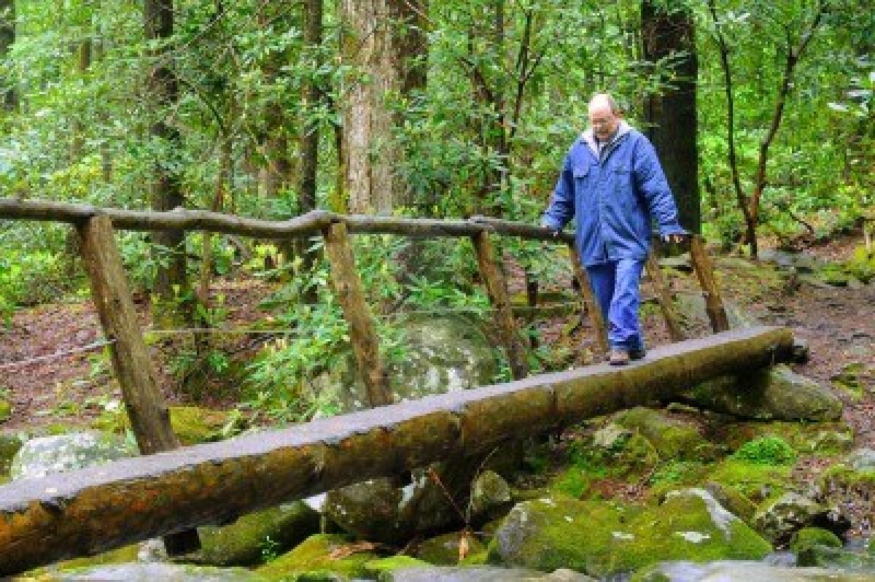
Gingerly
Delicately, tentatively, cautiously, carefully, gently
Adverb

Slide 10
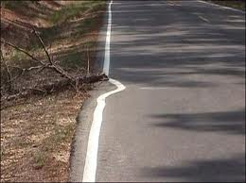
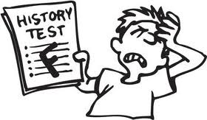
Deplore
To disapprove of, hate, disgusted by
Verb

Slide 11
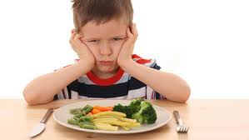
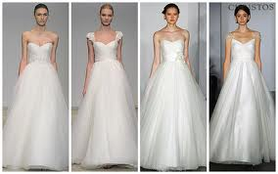
Fastidious
Fussy, picky, choosy, hard to please
Adjective

