Slide 1
VOCABULARY BONANZA
10/1/13

Slide 2
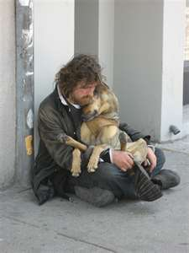
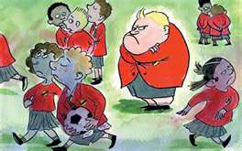
Ostracize
leave out someone, ignore, or banish with general approval from the larger group
Verb

Slide 3
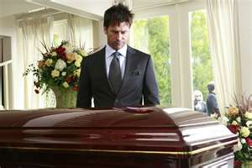
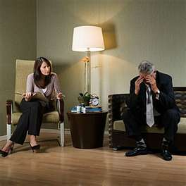
Morose
Miserable, depressed, unenthusiastic
Adjective

Slide 4
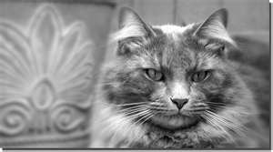
Aloof
Distant, detached, feeling apart from others
Adjective

Slide 5
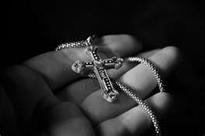
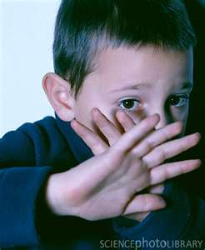
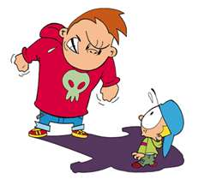
Cower
To tremble in fear, shrink away
Verb

Slide 6
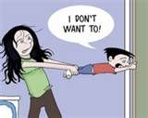
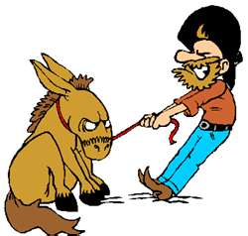
Obstinate
Stubborn, unyielding or unwilling to change your mind
Adjective

Slide 7
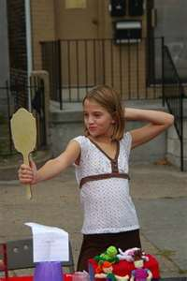
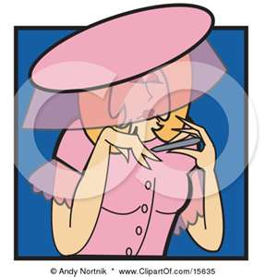
Haughty
Arrogant, conceited, stuck-up, snobbish
Adjective

Slide 8
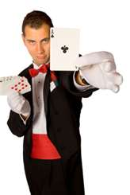
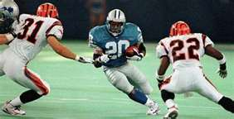
Feign
Pretend, fake, move with deception
Verb

Slide 9
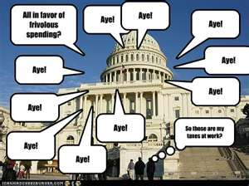
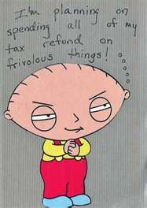
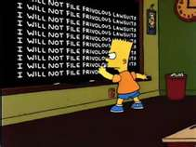
Frivolous
lack of seriousness or sense. playful, silly
Adjective

Slide 10
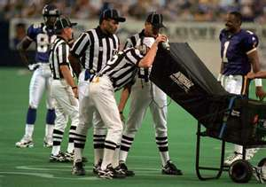
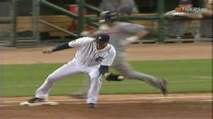
Scrutinize
Analyze, inspect, examine in detail
Verb

Slide 11
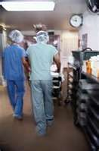
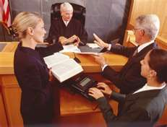
Diligent
constant in effort to accomplish something; attentive and persistent in doing anything, hardworking
Adjective

