Slide 1
Entertaining Vocabulary!
January 31, 2014

Slide 2
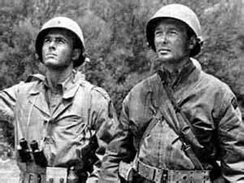
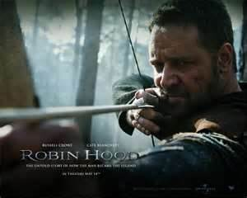
Gallantly
Brave, strong-willed, dignified, noble or chivalrous
Adverb

Slide 3
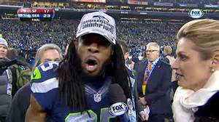
Contemptuously
Showing or expressing feelings of meanness, hatred or ill will towards another person
Adverb

Slide 4
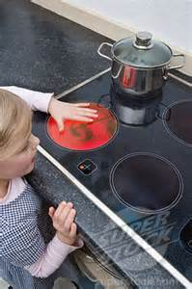
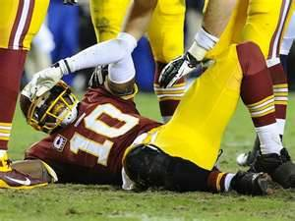
Winced
To draw back or tense, usually from pain or from a blow; start; flinch, startled.
Verb

Slide 5
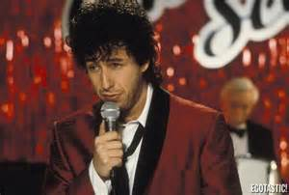
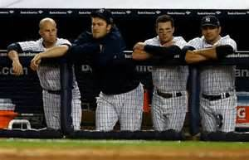
Despondent
Feeling or showing discouragement, hopelessness, dejection, or gloom
Noun

Slide 6
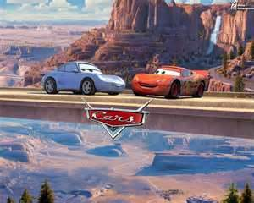
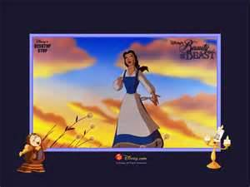
Wistfully
Long, yearn, reflective, wish for something
Adverb

Slide 7
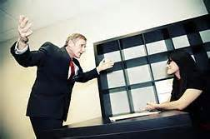
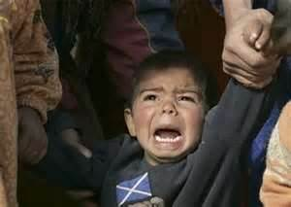
Quivering
To slightly shake or tremble, shivering
Verb

Slide 8
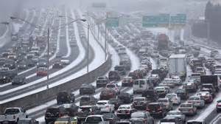
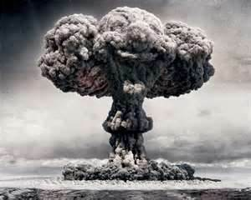
Incredulous
Hard to believe, doubting, implausible
Adjective

Slide 9
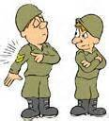
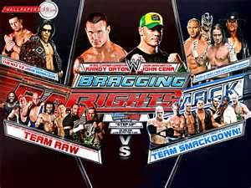
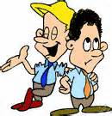
Braggart
Person who does a lot of boasting, bragging
Noun

Slide 10
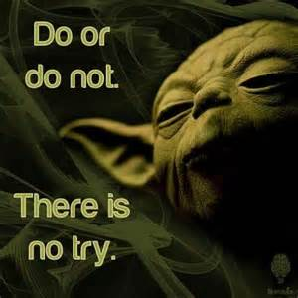
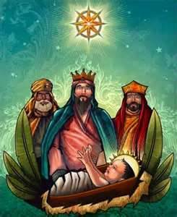
Sagely
Wise, clever, perceptive
Adverb

Slide 11
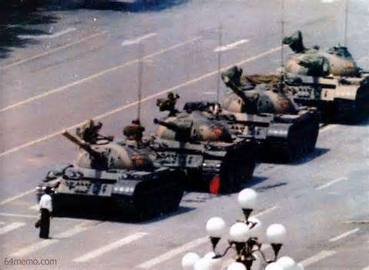
Convictions
Strong beliefs, morals, and passion
Noun

