Slide 1
Vocabulary Bonanza
January 14, 2014

Slide 2
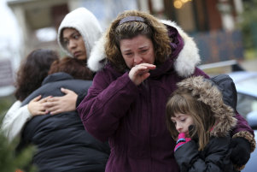
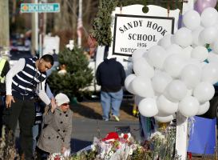
Lament
To mourn, grieve, feel a loss usually done while crying
Verb

Slide 3
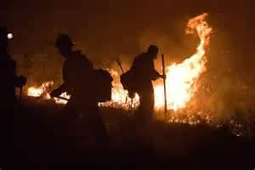
Hinder
To prevent from doing, stopping or delaying, blocking.
Verb

Slide 4
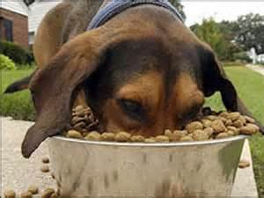
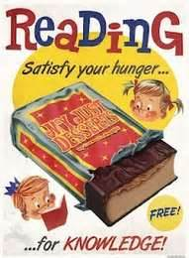
Ravenous
Extremely hungry, starving
Adjective

Slide 5
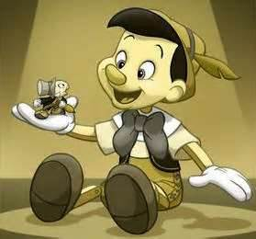
Candor
Sincere honesty and being outspoken, having truthfulness
Noun

Slide 6
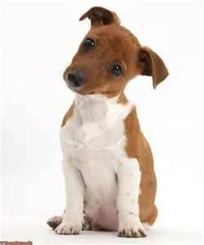
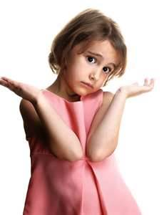
Quizzical
Questioning or puzzled, curious
Adjective

Slide 7
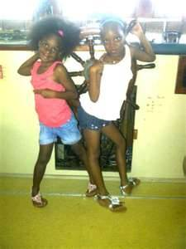
Inseparable
Incapable of being separated, always together.
Adjective

Slide 8
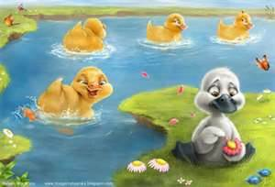
Aberration
Act of differing from what’s normal or usual, not regular
Noun

Slide 9
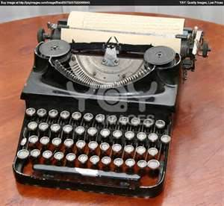
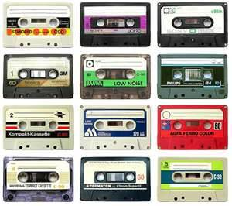
Obsolete
No longer useful, out dated, old fashioned
Adjective

Slide 10
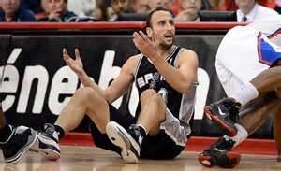
Embellish
To exaggerate, enhance or adorn.
Verb

Slide 11
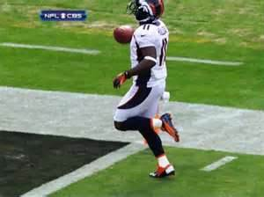
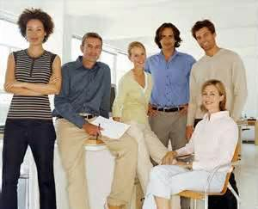
Nonchalant
Indifferent, casual, unconcerned, laid-back
Adjective

