Slide 1
Vocab Expression
March 25, 2014

Slide 2
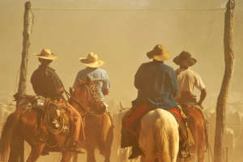
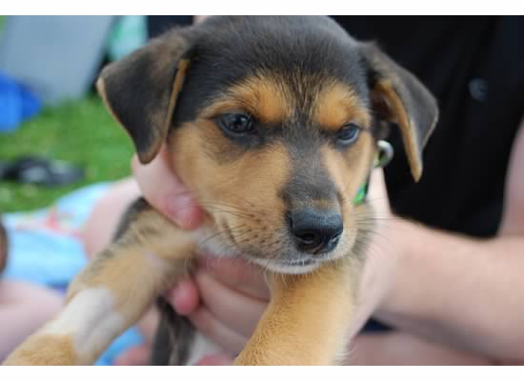
Docile
Easily managed, quiet, tame, trainable
Adjective

Slide 3
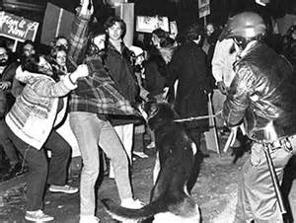
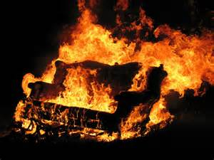
Incensed
Angry, riled up, irate, extremely upset
Adjective

Slide 4
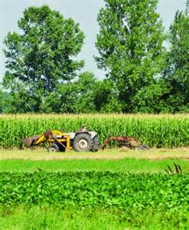
Thrived
To grow and blossom, increase tremendously, to prosper, to do well
Verb

Slide 5
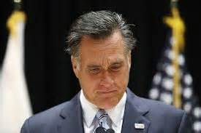
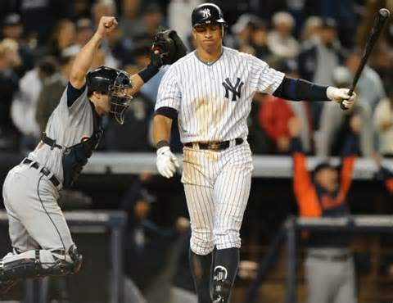
Resignation
Giving up, acceptance, grim understanding
Noun

Slide 6
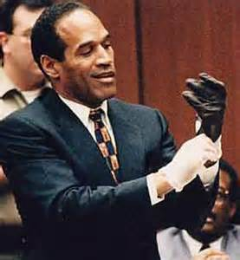
Farce
Mockery, shamble, huge joke, foolish show
Noun

Slide 7
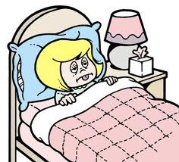
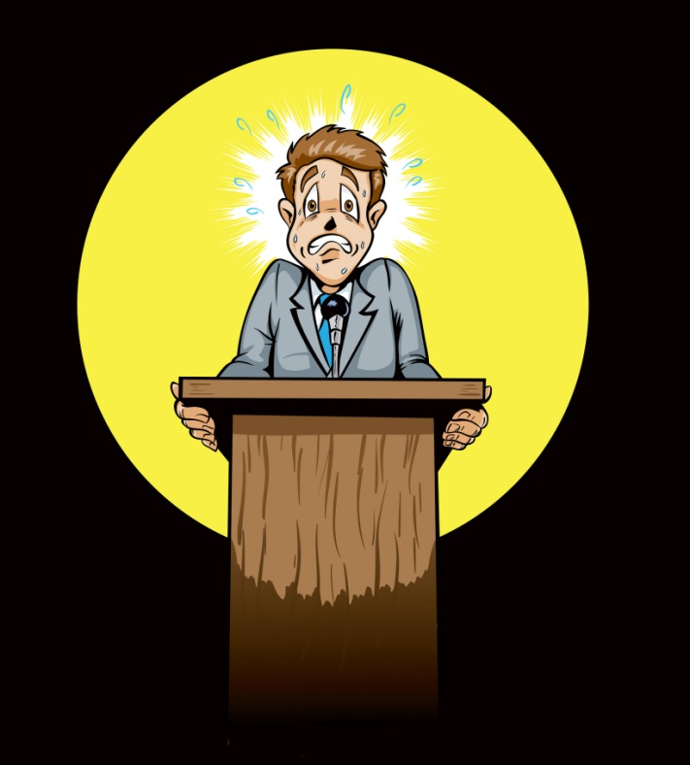
Clammy
Damp and cold, sweaty, moist, slimy
Adjective

Slide 8
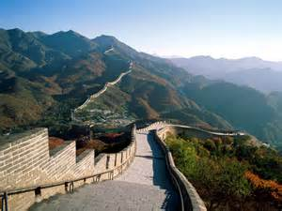
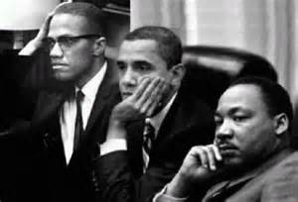
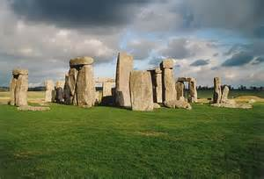
Profound
Deep, reflective, insightful thoughts or thinking
Adjective

Slide 9
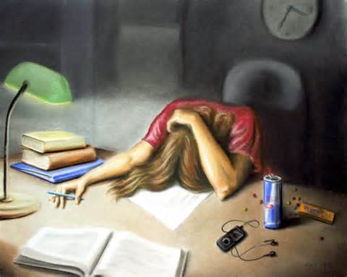
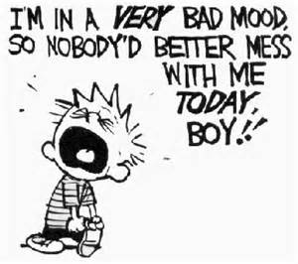
Surly
Rude, impolite, and generally mean, grouchy or crabby
Adjective

Slide 10
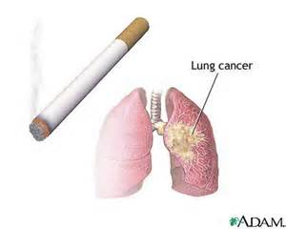
Deter
To discourage, prevent or restrain from continuing
Verb

Slide 11
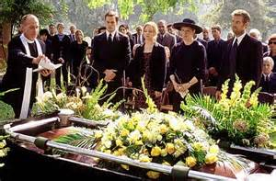
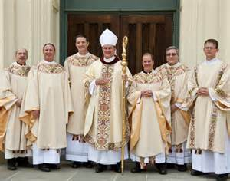
Reserved
Unassuming, aloof, keeping one’s thoughts to themselves
Adjective

