Slide 1
Vocabulary Addition
April 1, 2014

Slide 2
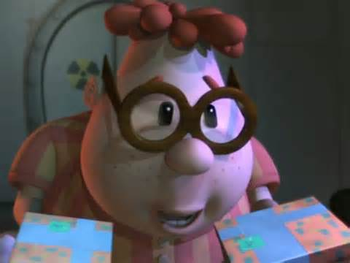
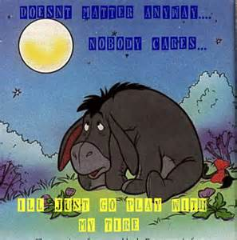
Cynical
Skeptical, bitterly distrustful, or pessimistic.
Adjective

Slide 3
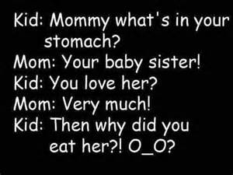
Innocuous
Inoffensive, harmless, innocent.
Adjective

Slide 4
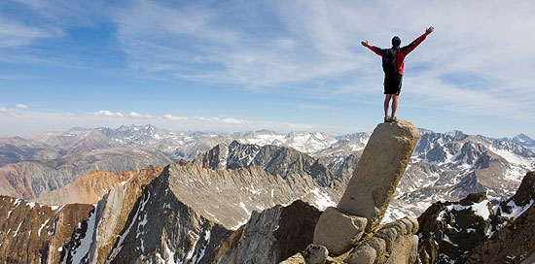
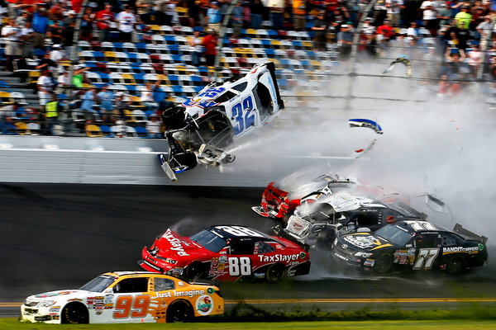
Gall
Courageousness, boldness, lots of nerve overconfidence
Noun

Slide 5
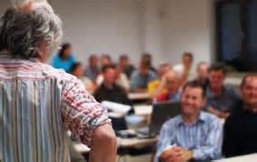
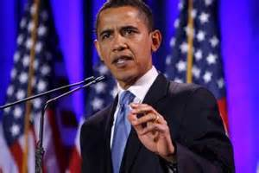
Retort
Reply angrily, sharply answer
Verb

Slide 6
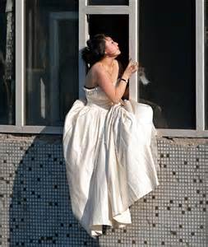
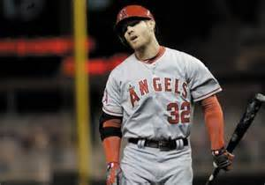
Spurn
Reject or snub in a mean manner
Verb

Slide 7
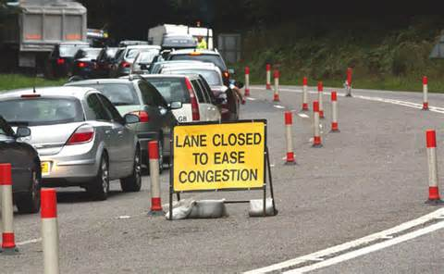
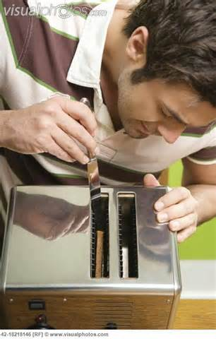
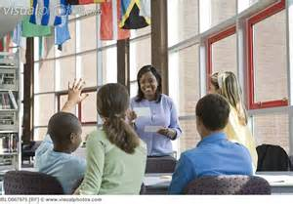
Inane
Foolish, childish, pointless, idiotic
Adjective
Can I ask you a question?

Slide 8
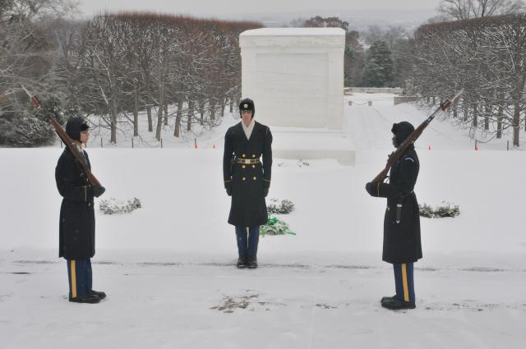
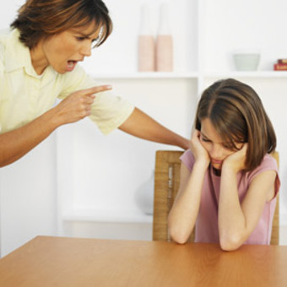
Adamant
Stubborn, inflexible, utterly unyielding in attitude or opinion
Adjective

Slide 9
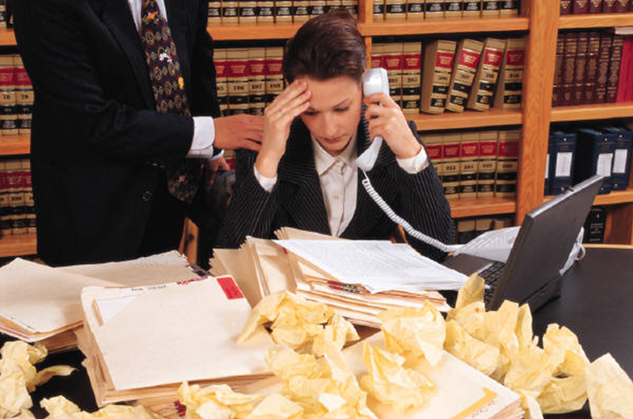
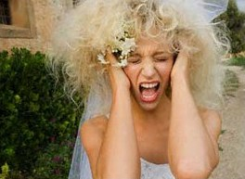
Frantic
Hysterical, anxious, desperate or wild with excitement, passion,
Adjective

Slide 10
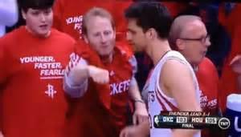
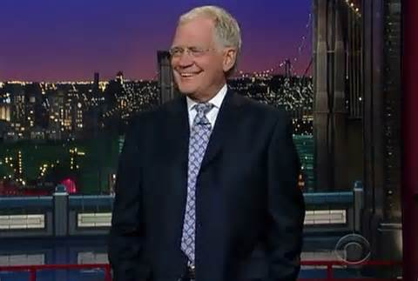
Jest
Joking around, teasing, bantering remark
Noun

Slide 11
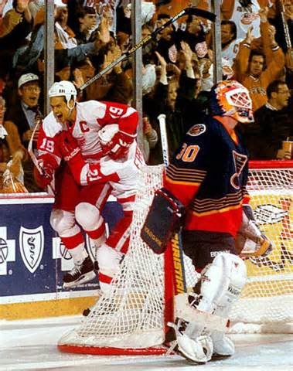
Jubilant
Extremely happy, overjoyed, triumphant
Adjective

