Slide 1
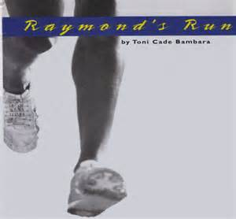
Plot Map

Slide 2
Characters
Squeaky - Protagonist
Raymond – Her Brother
Gretchen – Antagonist
Rosie – Gretchen’s Sidekick
Mary Louise – Gretchen’s Sidekick
Mr. Pearson – Track Official

Slide 3
Exposition
Squeaky Watches her older brother Raymond
She trains hard for track
People call her Squeaky because of her voice
She’s called Mercury because she’s the fastest in her neighborhood.
Only her father can beat her, and that’s with a head start

Slide 4
Exposition cont.
Squeaky describes why she makes her brother walk on the inside of the sidewalk
Squeaky describes how she trains
Squeaky talks about how Cynthia Porter makes people think everything comes easy to her
Finally, Squeaky states Raymond keeps up with her running; if he doesn’t someone is likely to take advantage of him

Slide 5
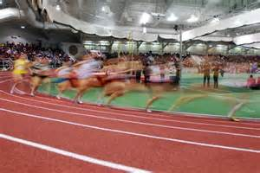
Main Conflict
Squeaky meets Gretchen and her sidekicks on a sidewalk- They “debate” who is the fastest

Slide 6
Rising Action
Squeaky at first thinks about ducking away from them
She doesn’t back down from them and even calls the other two “shadows”
When Gretchen’s sidekicks see that they are not bothering Squeaky, they start in on Raymond
Squeaky quickly comes to his defense

Slide 7
Rising Action cont
The next day, Squeaky takes her time getting to the races
She describes her time as a participant in the school play, stating “she’s not a strawberry”
Squeaky puts Raymond in a little kid’s swing even though he is obviously too big for it
Squeaky registers for the race and becomes upset with Mr. Pearson

Slide 8
Rising Action cont
Squeaky stomps away from him in anger as he suggests she let someone else win
Squeaky stretches, warms up and watches the younger kids race
Her race is called, she removes her warmup sweats
As she lines up, she notices Raymond lining up just like her outside the track fence

Slide 9
Climax
Imagining herself in a dream, the race begins
Gretchen is a blur next to her, with “chin jutting out like it’s going to win by itself”
Raymond is running in his own style with both of them
The climax ends with Squeaky describing the white ribbon bouncing towards her

Slide 10
Falling Action
Everyone runs up to Squeaky and slaps her on the back in congratulations
An argument is heard over the race finish on the loudspeaker
Squeaky begins to see both Raymond and Gretchen in a new way
Raymond climbs the fence and it makes Squeaky see him as graceful and athletic

Slide 11
Resolution
Squeaky decides to try and be friends with Gretchen
She is going to retire from racing and train Raymond
Squeaky is also going to ask Gretchen for her help in training Raymond as any fool can see Gretchen is serious about racing
Finally, the girls smile at each other in new found respect

