Slide 1
Characters
Types found in Literature

Slide 2
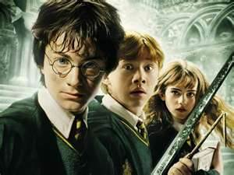
Major Character
Often the Protagonist
Focus of the reader’s attention

Slide 3
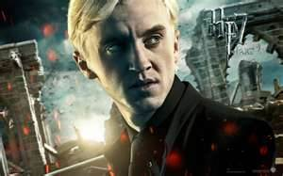
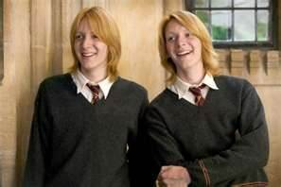
Minor Characters
Takes part in the story’s events
Attention not focused on them
Often helps the reader learn about the main character

Slide 4
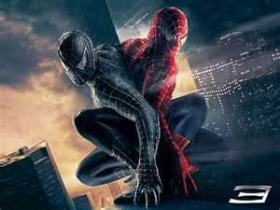
Round Characters
Have many different character traits that sometimes contradict each other
Behave like real people as author gives lots of details about their personality
Major characters are almost always Round

Slide 5
Flat Character
Have only one or two personality traits and can be summed up in a few words.
Have no depth, like a piece of cardboard. Often are sterotypes.
Character remains the same at the end of the story as they were at the beginning.

Slide 6
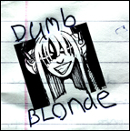
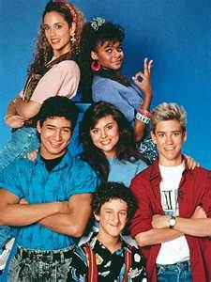
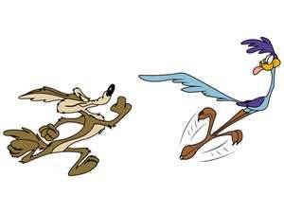
Flat Character Examples

Slide 7
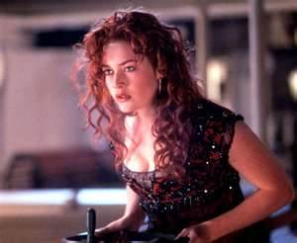
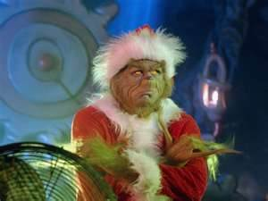
Dynamic Character
A character who CHANGES internally in the course of a story.
Internal change can be
Personality
Beliefs
Feelings
Outlook on life

Slide 8
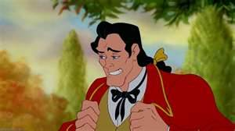
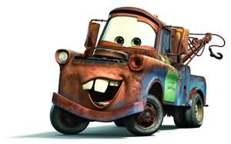
Static Character
A character who doesn’t change and remains the same throughout a story.
They do not change internally

Slide 9
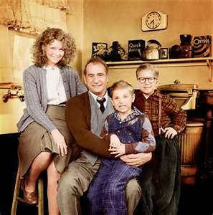
Who’s the Major Character?
Ralphie

Slide 10
Who’s the Flat Character?
Mom, Dad and little brother Randy

Slide 11
Who’s the Dynamic?
Ralphie

